Slide 1
Smart, Adaptive Compression Therapy Device
Shahram Pourazadi
Spring 2018

Slide 2
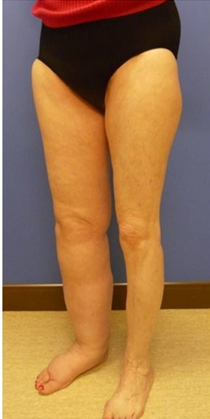
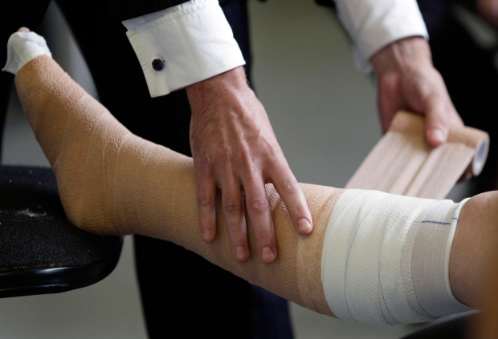

Slide 3

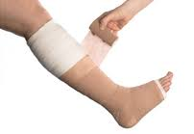
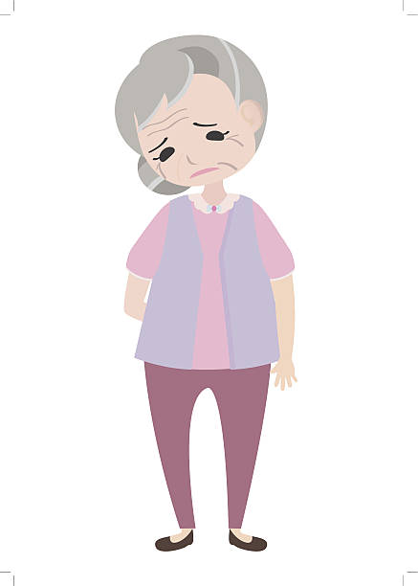


3-5 days/week
2-12 weeks

Slide 4
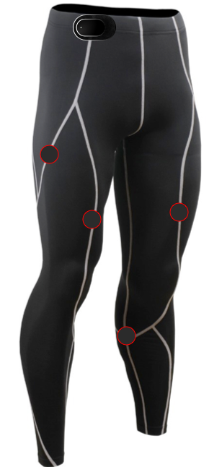


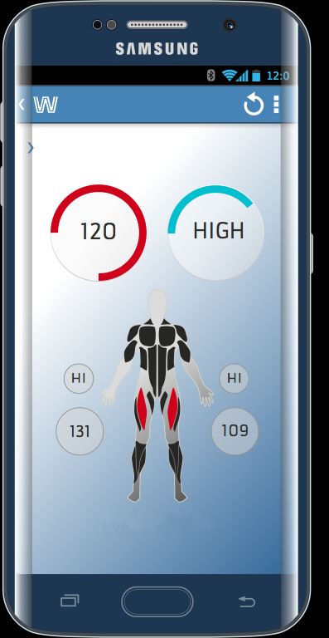


Slide 5
Let’s help 10 million patients like Sarah just in North America, to have a better life by providing them with an enhanced treatment!
Let’s improve the quality of service of many clinicians just like John and reduce the costs of many hospitals just like VGH!
Thank you!

